Slide 1
Large-Scale and Multi-Structured Databases Project Design PixelIndex
Ceccanti Lorenzo
Corsi Cristiano
Mulé Niccolò

Slide 2
Application Highlights
The application is useful for:
Manage your game collection:
Keeping track of your videogame library and add new games with ease
Wishlist:
Add games to your wishlist to keep track to the titles you want to play next filtering by platform, genre or release date
Reviews:
Share gaming experiences through detailed reviews and rate others' reviews to highlight the most helpful ones
Join the gaming community:
Connect with other players following their activities
Notes:
LC

Slide 3
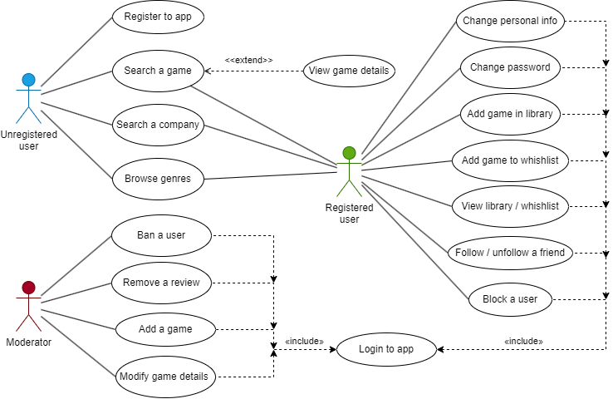
Actors and main supported functionalities
Notes:
LC

Slide 4


Dataset Description
Source: IGDB.com, Steam
Description:
IGDB.com is a video games database with an API for developers
Steam is a leading digital distribution service for video games. Web scraping techniques were used to extract authentic reviews from their storefront.
Volume: about 850 MB, more specifically:
Over 250K video games
Over 500K reviews
Variety: Video games data was obtained by cross-referencing Steam and IGDB
Velocity/Variability: N/A
Notes:
NM

Slide 5
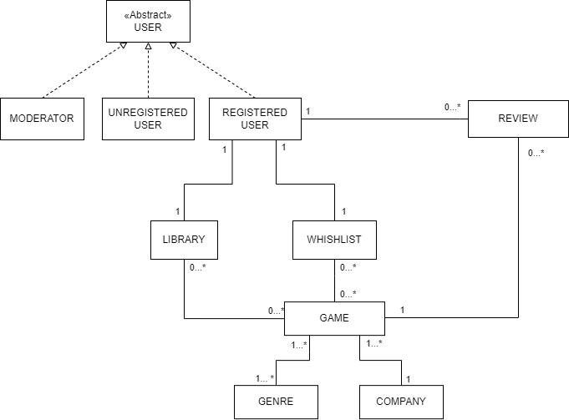
Preliminary UML Class Diagram
Notes:
NM

Slide 6
Requirements and Entities handled by Document DB
Entities involved:
User
Game
Review
Library
Wishlist
Genre
Company
Main requirements:
Seeing the most added in library games during the current year for each specific platform in order to display them into the "Highlighted" section of the application
Show the "Not recommended" reviews for the games you have put into the wishlist
The user can view the percentage distribution of games played, grouped by genre selecting a time period.
Notes:
CC

Slide 7
Requirements and Entities handled by Graph DB
Game
Entities involved:
User
Game
Review
:ADD_TO_LIBRARY
User
:LIKE
:DISLIKE
Review
:FOLLOW
Main requirements:
A registered user is suggested with the people he/she might know
A registered user is suggested with the games that his/her friends liked (more popular games first)
Rank the user according to the number of connections with other user and with the number of games they added.
Suggest the most useful reviews based on the number of likes
Notes:
CC

Slide 8



Software Architecture Preliminary Idea
The front-end will be offered through a Command Line Interface
DBMSs:
Programming languages: Java w/ Maven for handling dependecies (mongodb-driver-sync, neo4j-java-driver) and Python for Web Scraping part (requests & Beautifoul Soup 4).
Data & Analytics Visualization:
Notes:
CC

